Slide 1

DEPARTMENT OF COMPUTER SCIENCE ALIGARH MUSLIM UNIVERSITY, ALIGARH
Week #2
4# Presentation (CAMS-1P01)
Suicide Awareness
Presented By
Mohd Rameez Khan

Slide 2
Table Of Contents
1. Introduction
2. Suicide Trend Infographic
3. Debunking Myths
Risk and Protective Factors
Conclusion

Slide 3
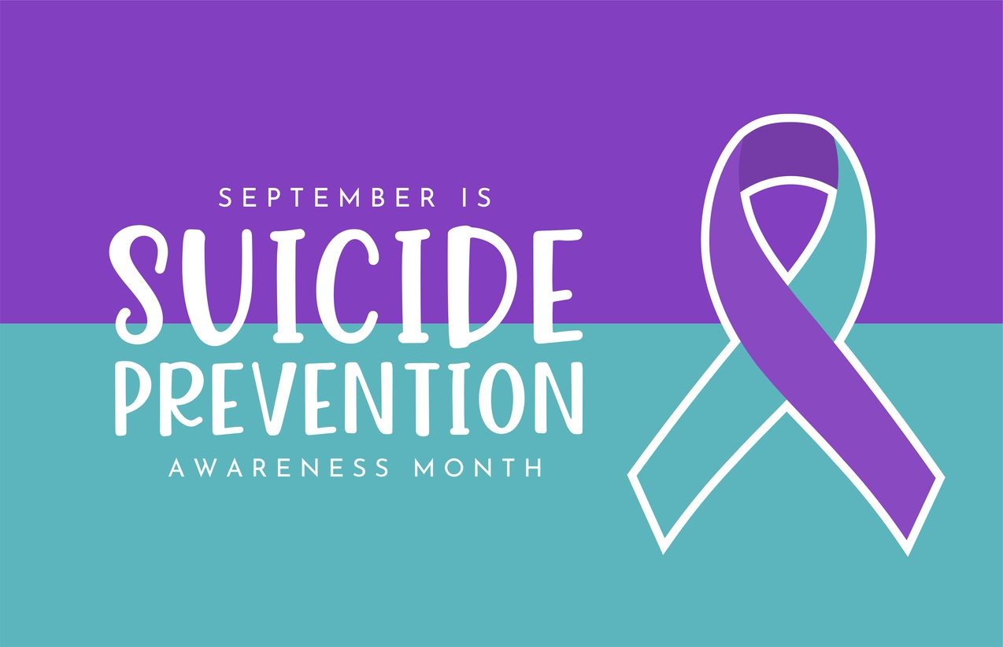
1. Introduction
More than 700 000 people die due to suicide every year.
For every suicide there are many more people who attempt suicide. A prior suicide attempt is an important risk factor for suicide in the general population.
Suicide is the fourth leading cause of death among 15–29-year-olds.
Seventy-seven per cent of global suicides occur in low- and middle-income countries.
Ingestion of pesticide, hanging and firearms are among the most common methods of suicide globally.

Slide 4
2. Suicide Trend Infographic
Rate per 100,000 Population
Age Group (Years)

Slide 5
3. Debunking Myths
Myth | Fact
Talking about suicide or asking someone if they feel suicidal will encourage suicide attempts. | Talking about suicide provides the opportunity for communication.
Young people who talk about suicide never attempt or die by suicide. | Talking about suicide can be a plea for help and it can be a late sign in the progression towards a suicide attempt.
Suicide attempts or deaths happen without warning. | The survivors of a suicide often say that the intention was hidden from them. It is more likely that the intention was just not recognized.
If a person attempts suicide and survives, they will never make a further attempt. | A suicide attempt is regarded as an indicator of further attempts.
Once a person is intent on suicide, there is no way of stopping them. | Suicides can be prevented. People can be helped.
People who threaten suicide are just seeking attention. | All suicide attempts must be treated as though the person has the intent to die.
Only certain types of people become suicidal. | Everyone has the potential for suicide.

Slide 6
4. Risk and Protective Factors
Risk Factors
Depression
Substance use problems
Bipolar disorder
Schizophrenia
Personality traits of aggression, mood changes and poor relationships
Anxiety disorders
Access to lethal means including firearms and drugs
Prolonged stress, such as harassment, bullying, relationship problems or unemployment
Stressful life events, like rejection, divorce, financial crisis, other life transitions or loss
Exposure to another person’s suicide, or to graphic or sensationalized accounts of suicide
Discrimination
Protective Factors
Access to mental health care, and being proactive about mental health
Feeling connected to family and community support
Problem-solving and coping skills
Limited access to lethal means
Cultural and religious beliefs that encourage connecting and help-seeking, discourage suicidal behavior, or create a strong sense of purpose or self-esteem

Slide 7

5. Conclusion
Suicide is a complex issue with profound impacts on individuals, families, and communities.
While it can feel overwhelming, it's crucial to remember that it's not insurmountable.
By fostering open conversations, reducing stigma, and providing accessible mental health support, we can create a world where hope prevails over despair.
Every life lost to suicide is a tragedy. Let us commit to being part of the solution.
By recognizing the signs, reaching out to those in need, and prioritizing mental well-being, we can work together to prevent suicide and build a future where everyone feels valued and supported.
Suicide Awareness PSA

Slide 8
References
Suicide (who.int)
Suicide in Canada: Key Statistics (infographic) - Canada.ca
The Myths & Facts of Youth Suicide (nv.gov)
Risk factors, protective factors, and warning signs | AFSP

Slide 9
Thank You!

